Slide 1
Around school
2nd form

Slide 2

New words: school

Slide 3



Library

Slide 4
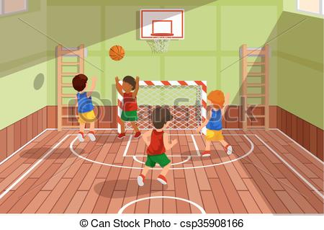

Gym

Slide 5
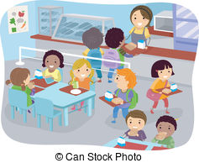
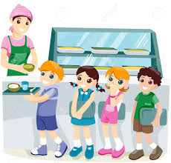
Canteen

Slide 6
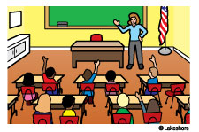
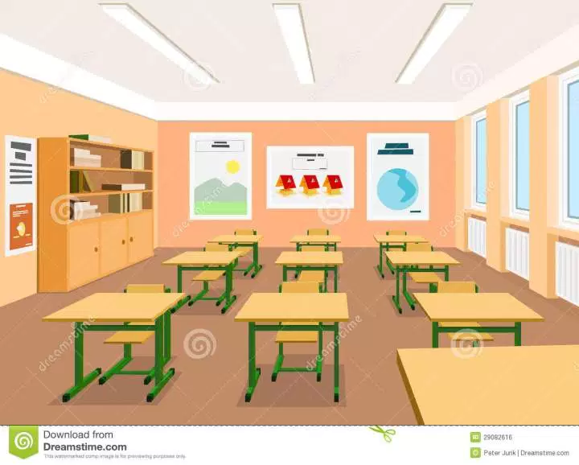
Classroom

Slide 15
- Is this a canteen? -no It isn’t. it is a classroom.

Slide 16
- Is this a school? -Yes, it is.

