Slide 1
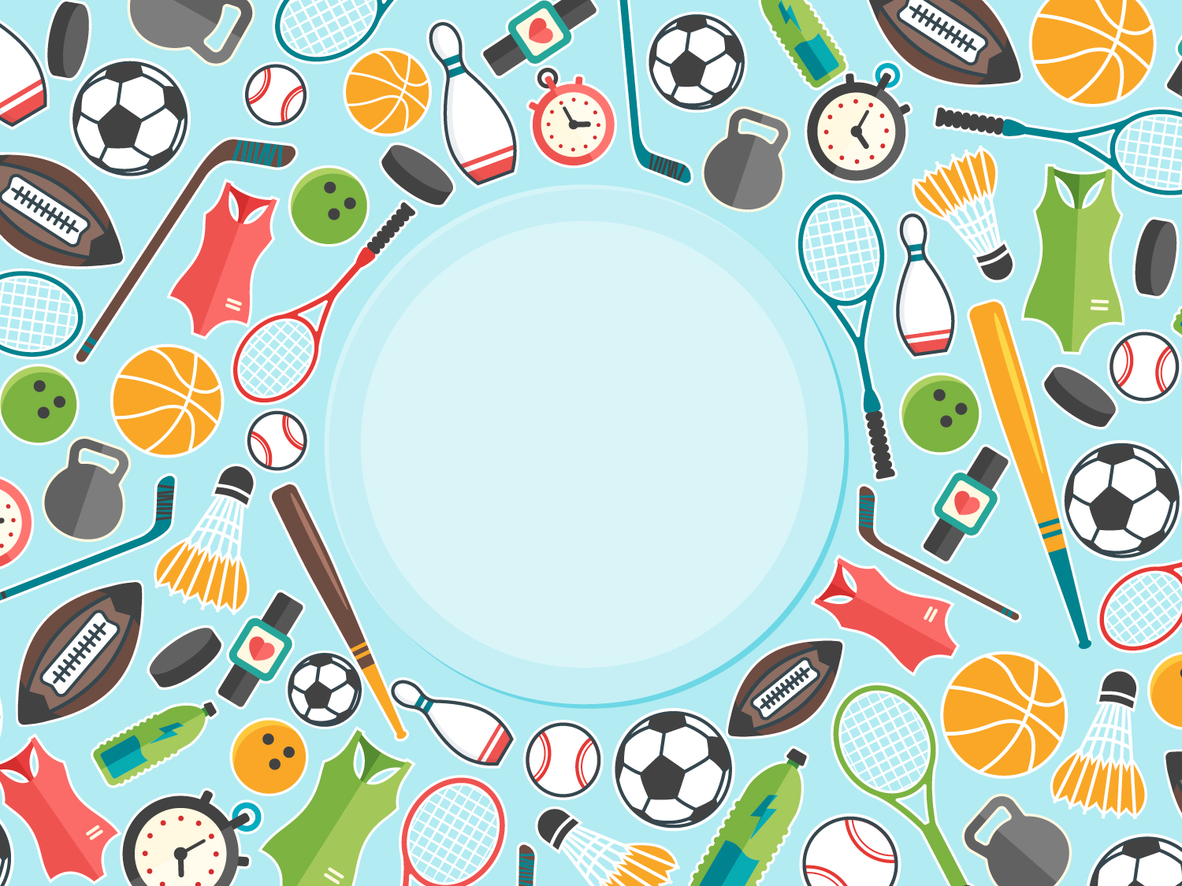
Are you fit?

Slide 2
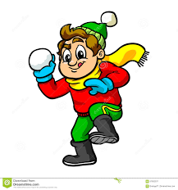
The 26th of September
Let’s play the game

Slide 3
Odd one out:
Football, helmet, tennis, rugby.
Goal, ball, football player, field.
Rowing, bob slaying, curling, figure skating.
Hockey, skating, chess, skiing
Running, boxing, cycling, golf.

Slide 4
Divide given words into 2 groups:
Mountain climbing, archery, fishing, badminton, netball, swimming, chess, horse racing, walking, handball, wrestling, hiking, bird-watching, water polo, table tennis.
Active kind of sport | Why people do sport? | Passive kind of sport

Slide 5



Group work:
Group “Football” read about the USA.
Group “Basketball” – Australia
Group “Volleyball”- the UK

Slide 6
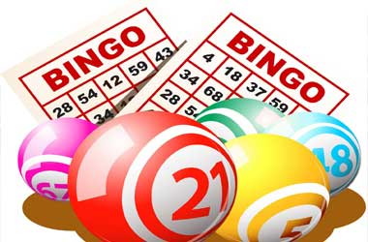
“Bingo” game
 | Naurysbay | Nuray T | Gau-khar | Sabina | Nuray O | Nurly-khan | Nazar-bay | Anel | Ayau-zhan
Do you do exercises in the morning?
What is your favourite kind of sport?
What do you think about passive sport?
What sports have taken the origin in Britain?
What are the most spectacular sports in the USA?
Do you know any famous American basketball players?
What do a lot of Australians think?
Where do more that 100 000 people go every year?

Slide 7




Feed-back:
It was new for me…
It was interesting for me…
It was useful for me…
It was important for me…

